Slide 1
LHL Bootcamp July 2020 – W4D1 Dimensionality Reduction
Arunabh singh

Slide 2
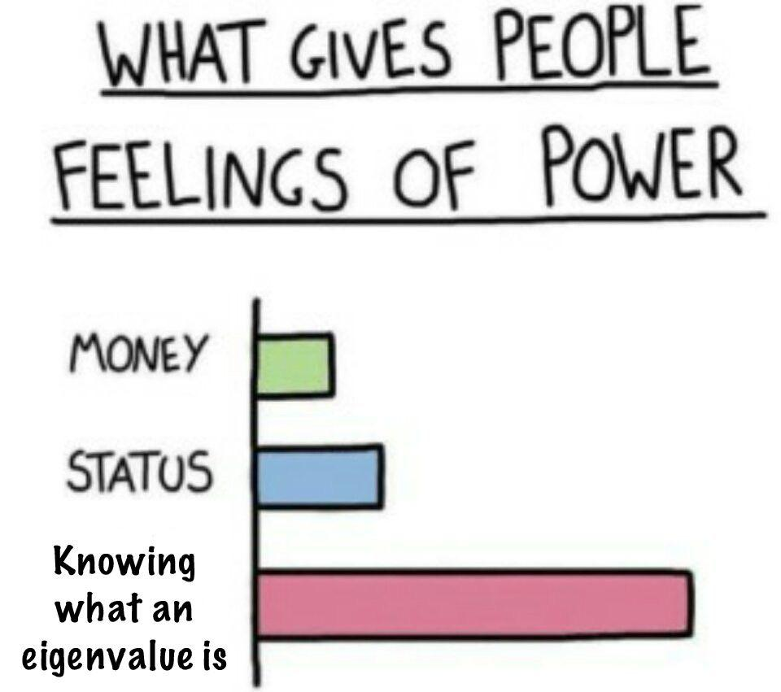
Dimensionality Reduction is Powerful

Slide 3
Use of Dimensionality reduction
Curse of Dimensionality is the problem of dealing with data that occurs in more than 3 dimensions or in higher dimensions.
Higher Dimensions are computationally intensive. Especially if your algorithms perform complex mathematical operations.
Accuracy can get effected by unrelated or useless variables(unrelated or low correlation with target).
Plotting and visualizing is difficult.
Usually text and Image data are where number of independent variables grows exponentially and uncontrollably.
Just a regular image on your system( 720 by 1080 pixels) if flattened to a row of independent variable where each pixel is a column totals to a whopping 777600 variables.
The only way to deal with this data before applying an algorithm is to reduce its dimensions to a reasonable value.

Slide 4
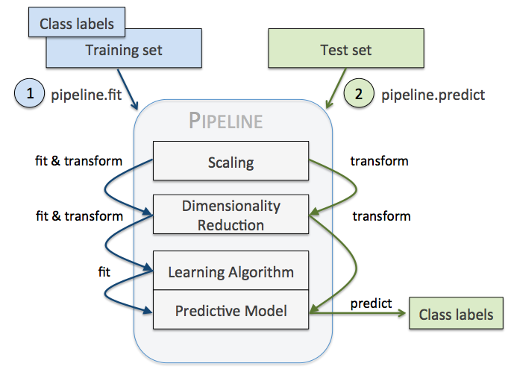
PCA/Dimensionality Reduction in ML Pipeline

Slide 5
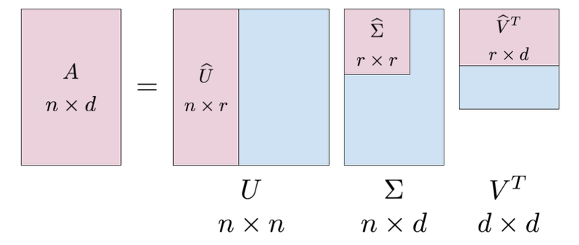
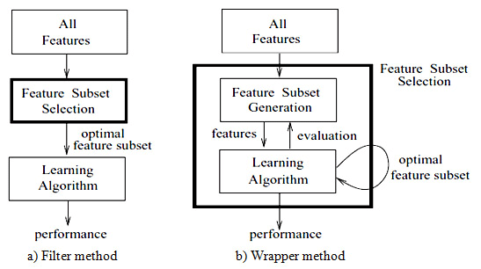
Dimensionality Reduction Types
Using Matrix decomposition (SVD,PCA, LDA)
Using Filter and Wrapper Methods

Slide 6

PCA working
Suppose we have a dataset x(1),x(2),…,x(m) with n dimension inputs. We want to reduce the data from n dimension to k dimension (k<<n) using PCA.
Compute the covariance matrix of the whole dataset ( sometimes also called as the variance-covariance matrix
Find Eigen values and Eigen Vectors from Covariance Matrix created using all dimensions(all variables present in the data).
Cov * h = Lambda * h (cov is the cov matrix and lambda is the eigen value to be calculated. Here h is the Eigen Vector to be calculated.
After obtaining eigen values, sort them in descending order.

Slide 7
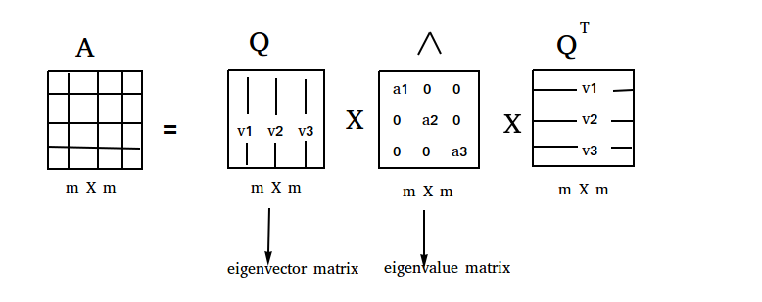
PCA working continued…
We now have new Dimensions on which we projected our data points.
These dimensions are lossy but with least amount of data lost.
Performing SVD on Cov Matrix using USV-Transpose to decompose the cov matrix into 3 matrices of mXd dXd and dXn also gives eigen values in direction of maximum variance.
Using SVD instead of calculating Eigen Values and Eigen Vectors directly is more computationally efficient.

Slide 8
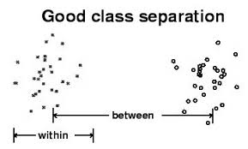
Dimensionality Reduction using LDA
Stand for Linear Discriminant Analysis
Compute the d-dimensional mean vectors for the different classes from the dataset.
Compute the scatter matrices (in-between-class and within-class scatter matrix).
Compute the eigenvectors (ee1,ee2,...,eed) and corresponding eigenvalues (λλ1,λλ2,...,λλd) for the scatter matrices.
Sort the eigenvectors by decreasing eigenvalues and choose k eigenvectors with the largest eigenvalues to form a d×k dimensional matrix WW (where every column represents an eigenvector).
Use this d×k eigenvector matrix to transform the samples onto the new subspace.

Slide 9
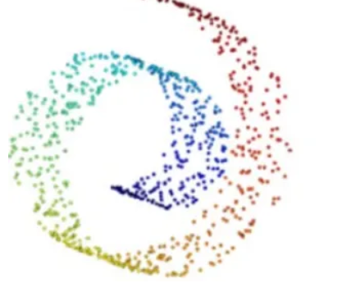
Projection Based Dimensionality Reduction - tSNE
t-SNE, unlike PCA, is not a linear projection. It uses the local relationships between points to create a low-dimensional mapping. This allows it to capture non-linear structure.
t-SNE creates a probability distribution using the Gaussian distribution that defines the relationships between the points in high-dimensional space.
t-SNE uses the Student t-distribution to recreate the probability distribution in low-dimensional space. This prevents the crowding problem, where points tend to get crowded in low-dimensional space due to the curse of dimensionality.
Though PCA is great, it does have some severe drawbacks. One drawback of PCA is that it is a linear projection, meaning it can't capture non-linear dependencies. For instance, PCA would not be able to "unroll" the following structure.

Slide 10
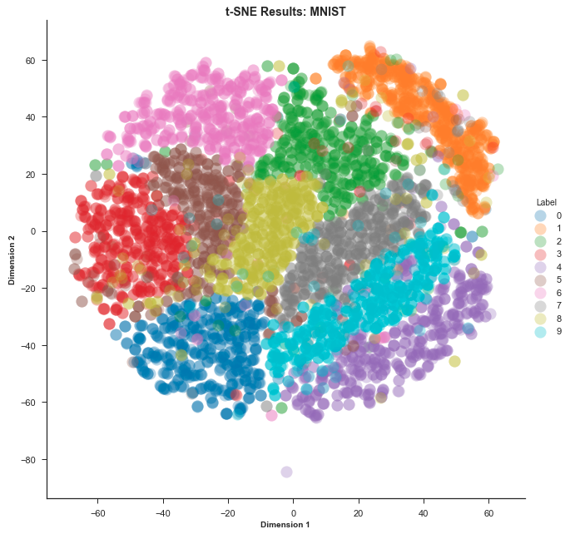
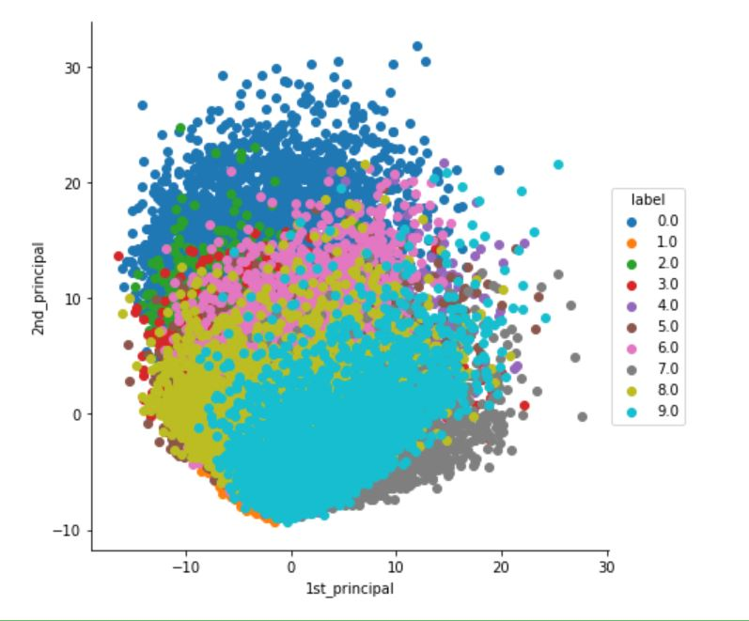
t-SNE example

Slide 11
Filter and Wrapper Methods
Filter methods - measure the relevance of features by their correlation with dependent variable
wrapper methods - measure the usefulness of a subset of feature by actually training a model on it.
Filter methods use statistical methods for evaluation of a subset of features while wrapper methods use cross validation.
Embedded Methods – They add Penalty against more complex models or more features. Example: L1 and L2 regularization ( Not for Today but good to know )

Slide 12
Filter and Wrapper Methods
Lets go through some of the methods in the following link: https://scikit-learn.org/stable/modules/feature_selection.html

